Slide 1
Coffee Survey
By Pujan Fanju

Slide 2
Background Information
James Hoffman collaborated with Cometeer and carried out the ‘Great American Coffee Taste Test (GACTT)’. This survey starts with him asking them some questions about themselves such as their gender, age group, how many coffees they typically drink per day, where they typically drink coffee etc. The participants are then given 3 samples of coffee to taste (A, B and C) and are asked which one they prefer.
Aim:
Carry out cleaning and transformation to analyse how the different demographic group (age and gender) answered the questions.
Apply random forest to see how accurately I can predict each participant’s coffee preference (A, B or C) based on how they answered some questions in the survey.

Slide 3
Demographics Analysis
The set of questions I wanted to analyse were:
How many coffees do you drink per day?
How do you typically drink coffee? (e.g. pour over, espresso, French press etc.)
Where do you typically drink coffee? (e.g. home, office, café etc.)
Which coffee do you prefer from the taste test? (A, B or C)
- Because 2 of the questions were multiple choice (2 and 4) and 2 were single choice questions (1 and 4), I would create a dataframe for the two single choice questions and a separate dataframe for each of the multiple-choice questions.

Slide 4
Methodology

Slide 5
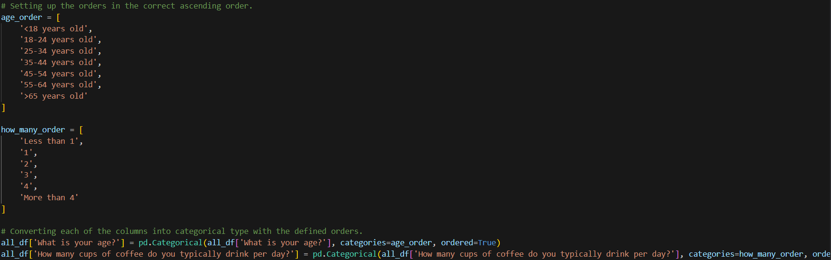
Transformation- converting to categorical datatype
The columns for the participant’s age group and how many coffees they typically drank per day had the datatype ‘object’, I first set this to ‘categorical’ instead to make sorting easier. It also makes it more memory efficient because it stores values of the same categories as integers- which makes grouping and aggregation quicker.

Slide 6
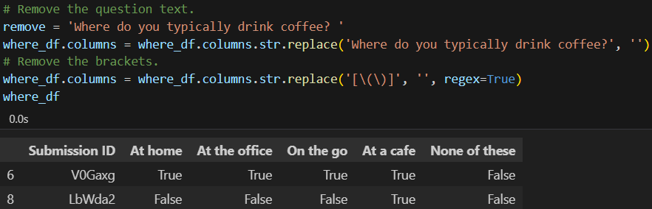
Transformation- re-formatting multiple choice questions (part 1)
Initially, each multiple-choice question had separate columns for each possible answers and the values were ‘True’ or ‘False’ depending on whether they picked the option or not.
However, this makes it very difficult to plot and analyse so we need to re-format it.
The first step is to tidy up the names of the columns to get rid of the question text and the brackets so that we have the answers only.

Slide 7
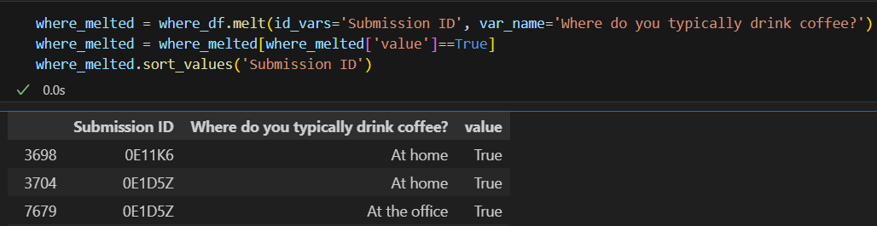
Transformation- re-formatting multiple choice questions (part 2)
Next step was to transform the dataset from wide format to long format. Each participant would have 5 rows (with each row being an option to the question). The third row had the ‘True’ or ‘False’ values depending on whether they picked that option or not. We filtered by ‘True’ as we only wanted the options that each participant actually picked.
The ‘value’ column was later dropped before exporting as a CSV.
The same process was repeated for the other multi-choice question (where do you typically drink coffee?).

Slide 8
Dashboard Analysis

Slide 9
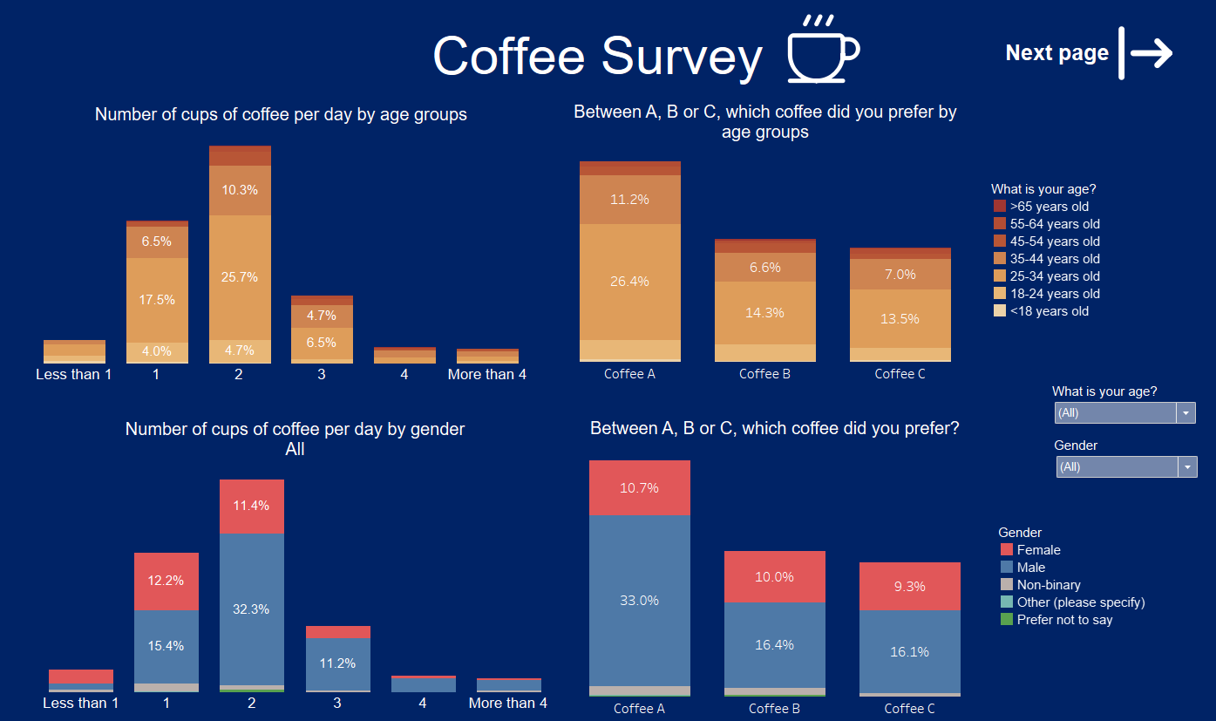
Dashboard part 1
I then exported the datasets onto Tableau and Created a dashboard to visualize the data.
This represents the number of cups of coffee drank per day and the coffee preference broken down by age and gender.
It is shown that most participants in the survey drank 2 coffees per day and Coffee A was the most preferred option overall.

Slide 10
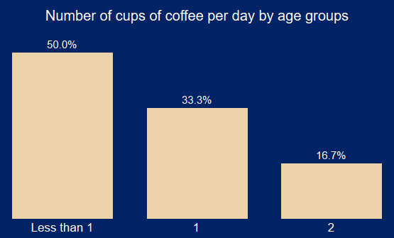
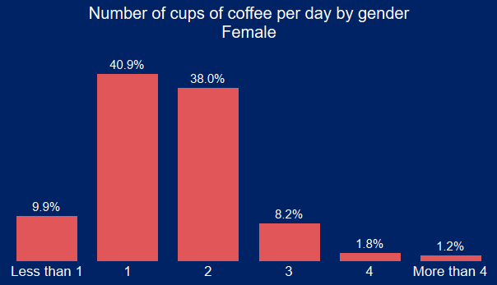
Dashboard part 1- additional insights
When filtering across all the age groups, I discovered that each of them had ‘2 coffees per day’ as the most common option. It was only the ‘Under 18s’ age group for which a majority (50%) picked ‘Less than 1’. This is no surprise as it’s not common for children to be drinking coffee.
Most participants across all genders said they drank 2 coffees per day except for females and non-binary- these groups said they drank 1 coffee per day.

Slide 11
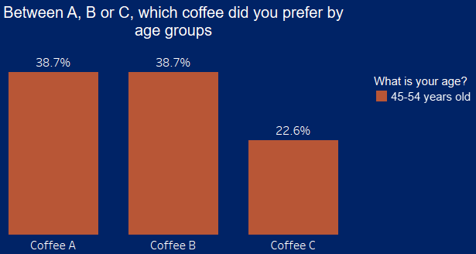
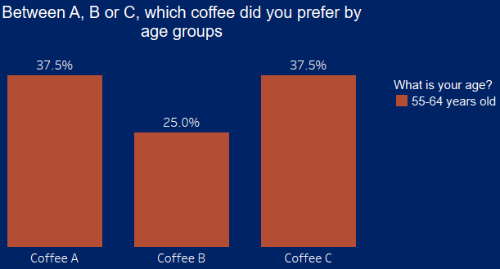
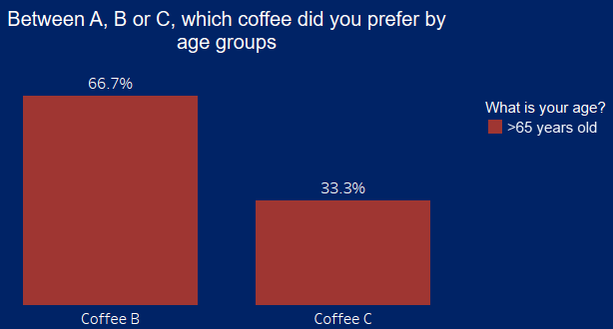
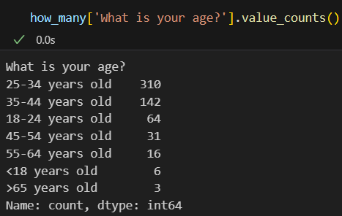
Dashboard part 1- additional insights
When filtering coffee preference by age group, I discovered that for all age groups up to 44, a significant majority preferred coffee A. From age groups of 45 and above, more participants are shown to prefer coffees B and C too.
Upon assessing the sample size of each age group, I found that the survey sample was not a good representation of the population. There are not enough participants in the older age categories (45+) to make any reliable conclusions.

Slide 12
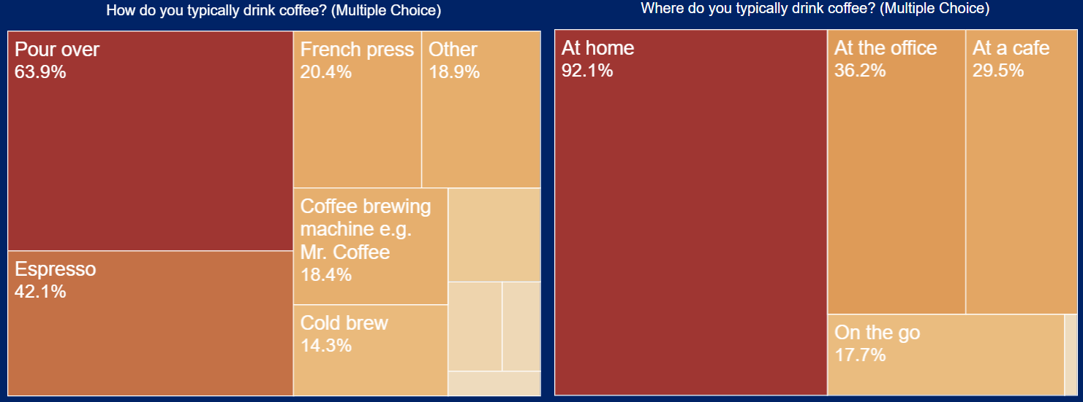
Dashboard part 2- additional insights
The most popular method people use to make coffee was ‘pour over’ followed by ‘espresso’.
The most common place people drank coffee was at home followed by at the office.

Slide 13
Predicting Coffee Preference Methodology

Slide 14
Predicting coffee preference
I wanted to test whether I’d be able to use data science models to predict which coffee (A, B or C) each participant would pick as their preferred choice.
The thing I am trying to predict (coffee preference of each participant) is called the ‘target’ or ‘dependent variable’. This is represented by ‘Y’.
The questions I am using to predict coffee preference is called ‘features’ or ‘independent variables’. This is represented by ‘X’.
The questions I thought would be relevant for this were:
  How do you brew coffee at home?
  On the go, where do you typically purchase coffee?
  Do you usually add anything to your coffee?
  What kind of dairy do you add?
  What kind of sugar or sweetener do you add?
  What kind of flavourings do you add?

Slide 15
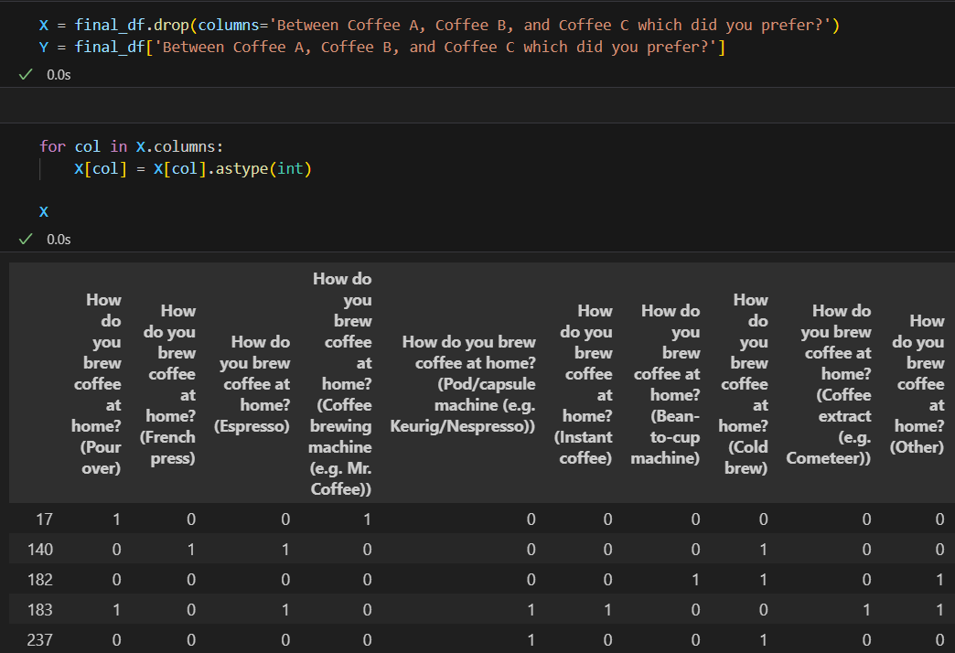
Setting up one-hot encoding
Categorical data (in this case, True or False for each option in the multiple-choice questions) must be converted to numerical data which machine learning algorithms can process.
After specifying the features (X) and target (Y), I convert every value in the features dataset into numerical value.
True = 1 (participant picked that option) , False = 0 (participant did not pick that option)

Slide 16
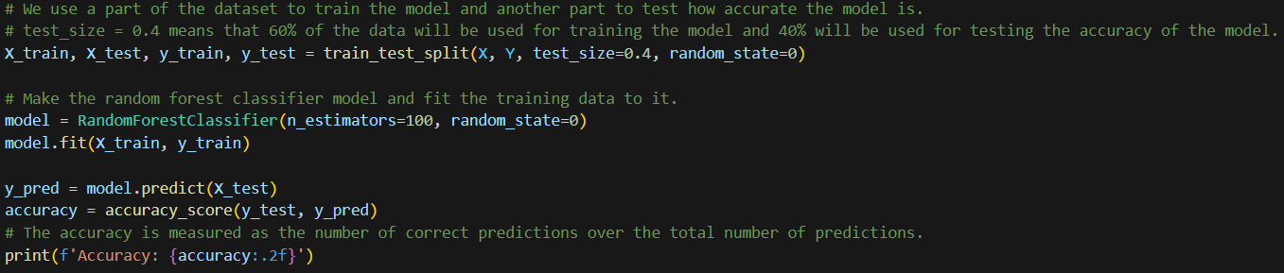
Fitting the model
After applying the encoding, I simply fit the ‘random forest classifier’ model. With test size = 0.4. This means that 40% of the data is used for testing the accuracy of the model and 60% is used for training the model.
However, the accuracy from this model was only 30%.
To attempt to improve the model, I took an additional step of only including features that were important.

Slide 17
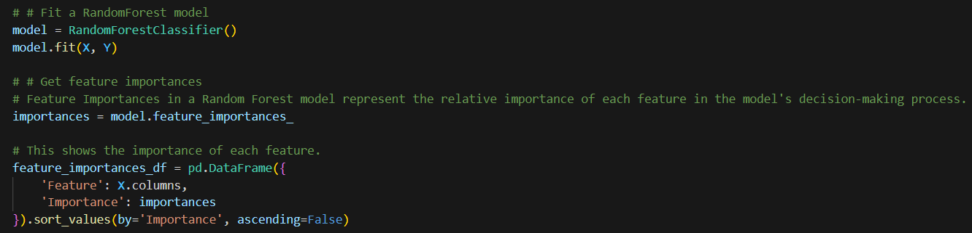
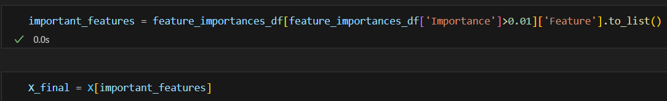
Feature Importance
The model I used was ‘random forest classifier’.
After fitting the model with my features and target, I extracted the ‘importances’ of each independent variable. This is how much each question contributes to the model’s decision-making process.
Choosing only important features will help to reduce overfitting. This occurs when the model learns the noise in the training dataset rather than the actual underlying pattern.
Upon re-running the model whilst only using features which had an importance value of more than 0.01, I managed to improve the accuracy to 46%.

